Slide 1


Online Convex Optimization Using Predictions
Niangjun Chen
Joint work with Anish Agarwal, Lachlan Andrew, Siddharth Barman, and Adam Wierman

Slide 2




$$c_{1}$$
$$c_{1}(x_{1})$$
$$x_{1}$$
$$F$$
Notes:
Consider the following sequential decision problem, at each time …

Slide 3




$$c_{2}$$
$$c_{2}\left(x_{2}\right)$$
$$x_{1}$$
$$x_{2}$$
$$F$$
$$β‖x_{2}−x_{1}‖$$
Notes:
The cost is the total of your action x applied to the function c, and also the distance moved away from your previous action

Slide 4
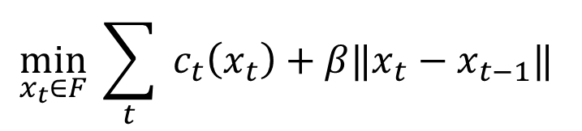







$$c_{3}$$
$$c_{3}(x_{3})$$
$$x_{1},c_{1},x_{2},c_{2},x_{3},c_{3}…$$
online
$$\min_{x_{t}∈F}{ \sum_{t}{{ c}_{t}\left(x_{t}\right)}+β‖x_{t}−x_{t−1}‖ }$$
convex
switching cost
Goal: Algorithms to minimize cost
$$x_{1}$$
$$x_{3}$$
$$x_{2}$$
$$F$$
$$β‖x_{3}−x_{2}‖$$

Slide 5
Lots of applications …
Dynamic capacity management in data centers [Tu et al. 2013]
Power system generation/load scheduling[Lu et al. 2013]
Portfolio management [Cover 1991][Boyd et al. 2012]
Video streaming [Sen et al. 2000][Liu et al. 2008]
Network routing [Bansal et al. 2003][Kodialam et al. 2003]
Geographical load balancing [Hindman et al. 2011] [Lin et al. 2012]
…
Notes:
A lot of online decision problem can be modeled as an OCO, for example, capacity management of data centers -> number of servers or virtual resource, -> adjust encoding bitrate to network condition, many Sigmetrics papers!

Slide 6
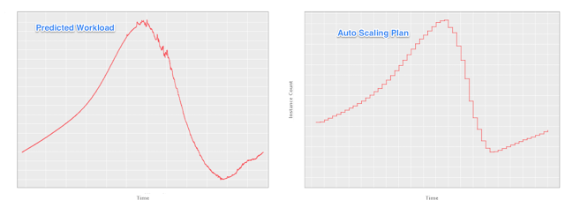
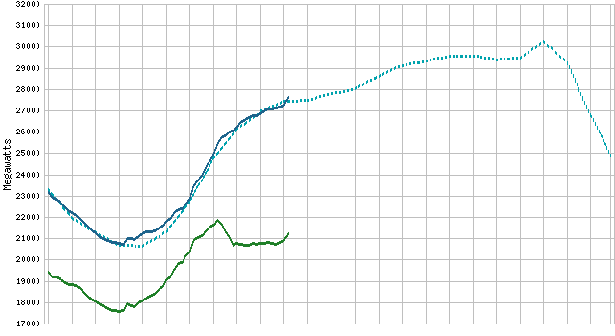
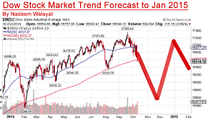
In most applications, predictions are crucial
But we do not have a good understanding about how (imperfect) predictions
impact online algorithm design
Notes:
Very often, we need to decide using external prediction (remember to tie to the previous applications) x label y label delete

Slide 7
This talk: Online Convex Optimization Using Predictions

Slide 8





$$c_{1|0}$$
$$c_{3|0}$$
$$c_{2|0}$$
$$c_{1}$$
$$c_{1}(x_{1})$$
$$x_{1}$$
$$F$$

Slide 9





$$c_{2}$$
$$c_{2|1}$$
$$c_{4|1}$$
$$c_{3|1}$$
$$c_{2}\left(x_{2}\right)$$
$$x_{1}$$
$$x_{2}$$
$$F$$
$$β‖x_{2}−x_{1}‖$$

Slide 10





$$c_{5|2}$$
$$c_{4|2}$$
$$c_{3}$$
$$c_{3|2}$$
$$c_{3}(x_{3})$$
$$x_{1}$$
$$x_{3}$$
$$x_{2}$$
$$F$$
$$β‖x_{3}−x_{2}‖$$

Slide 11
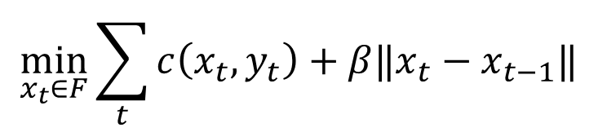

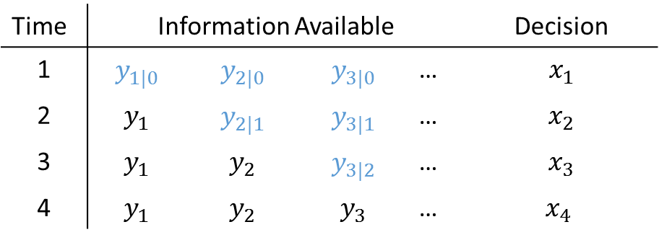
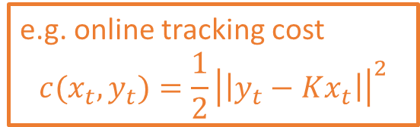

Online convex optimization using predictions
$$x_{1},y_{1},x_{2},y_{2},x_{3},y_{3}…$$
online
$$\min_{x_{t}∈F}{\sum_{t}{c\left(x_{t}, y_{t}\right)}+β‖x_{t}−x_{t−1}‖ }$$
switching cost
convex
e.g. online tracking cost
$$c(x_{t},y_{t})=\frac{1}{2}{\left|\left|y_{t}−Kx_{t}\right|\right|}^{2}$$
Given prediction of $y_{t}$at time $τ, y_{t|τ}$
Time | Information Available |  |  |  | Decision
1 | $$y_{1|0}$$ | $$y_{2|0}$$ | $$y_{3|0}$$ | … | $$x_{1}$$
2 | $$y_{1}$$ | $$y_{2|1}$$ | $$y_{3|1}$$ | … | $$x_{2}$$
3 | $$y_{1}$$ | $$y_{2}$$ | $$y_{3|2}$$ | … | $$x_{3}$$
4 | $$y_{1}$$ | $$y_{2}$$ | $$y_{3}$$ | … | $x_{4}$
Notes:
Parameterized family

Slide 12
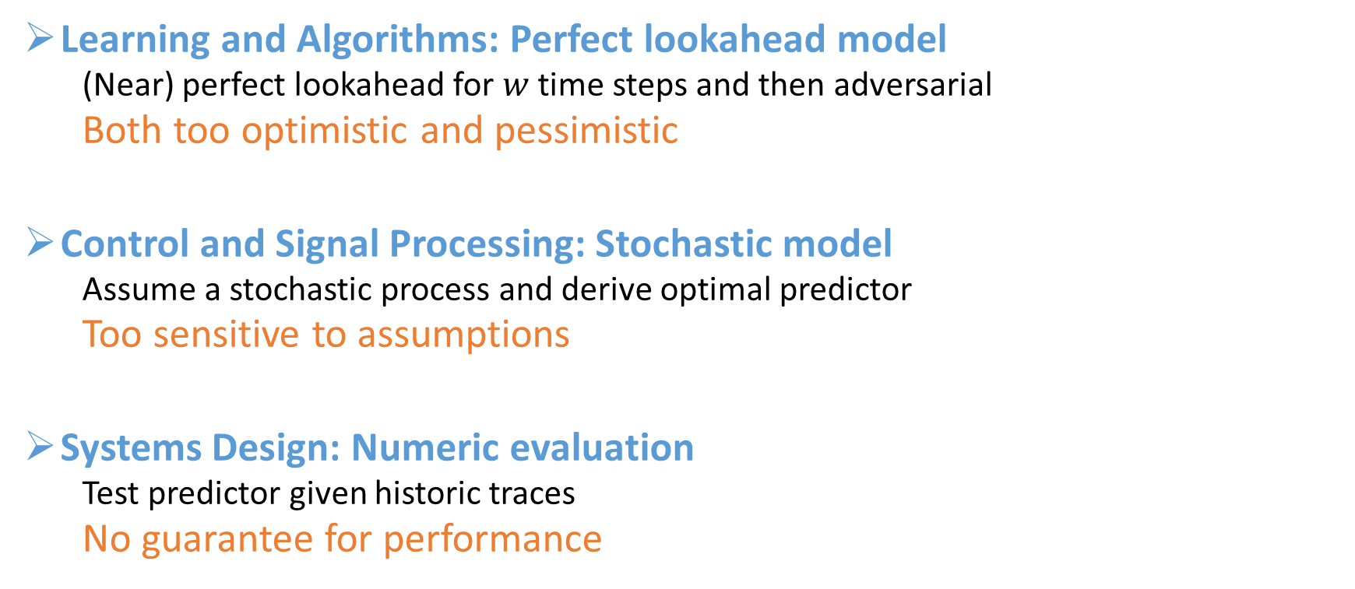
How do algorithms model prediction noise?
Learning and Algorithms: Perfect lookahead model
(Near) perfect lookahead for $w$ time steps and then adversarial
Both too optimistic and pessimistic
Control and Signal Processing: Stochastic model
Assume a stochastic process and derive optimal predictor
Too sensitive to assumptions
Systems Design: Numeric evaluation
Test predictor given historic traces
No guarantee for performance
Worst case analysis
Average case analysis
Notes:
Roughly break down into three communities , we need better model to have the best out of both worlds…

Slide 13
Our contribution: a general and tractable model for prediction
Key message: prediction allows
Overcoming “impossibility” results for OCO with minimal structural assumption
Mixture of average case and worst case analysis

Slide 14
Outline
Background : regret and competitive ratio
OCO without prediction
OCO with worst case prediction
Our prediction noise model
Algorithm design
OCO with stochastic prediction noise

Slide 15
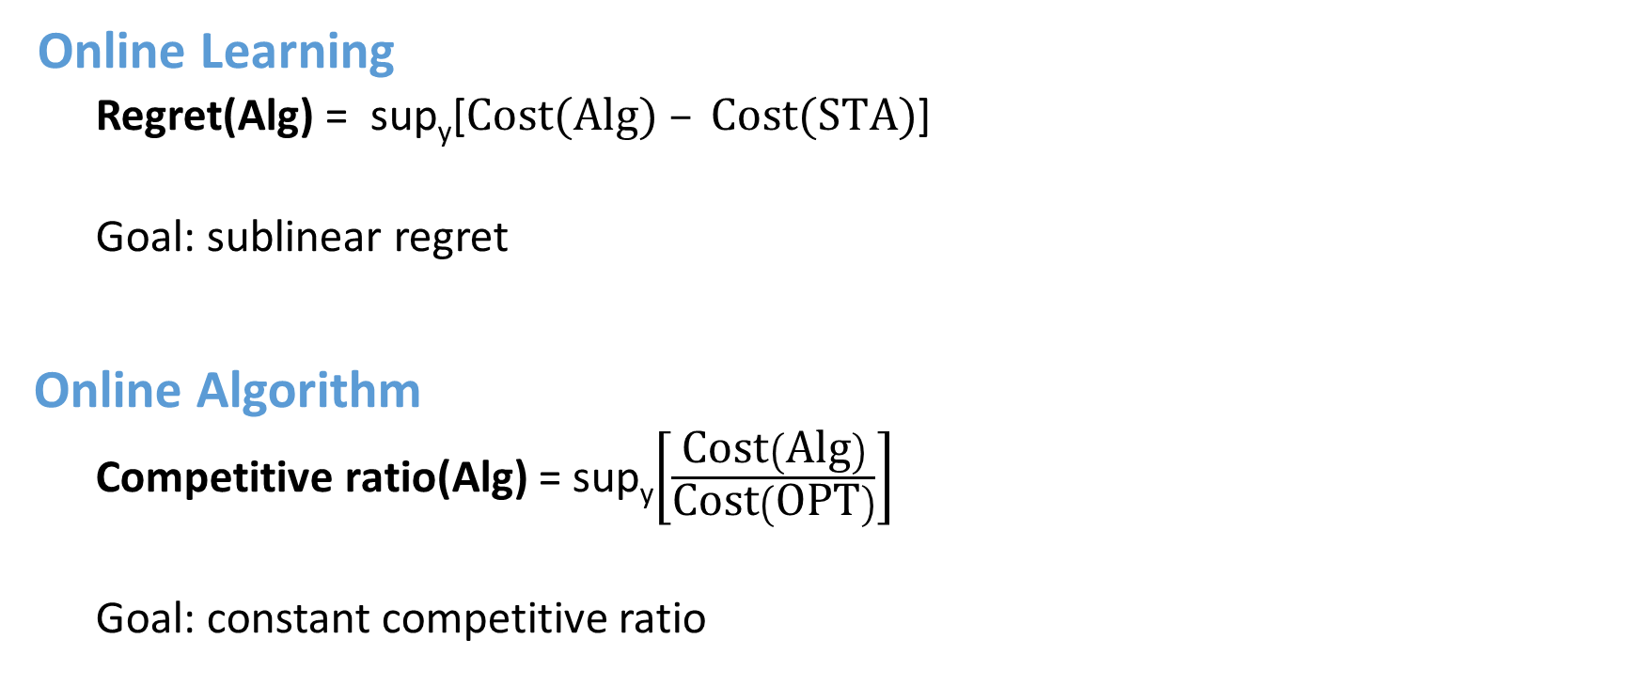
Two communities, two metrics
Online Learning
Regret(Alg) = sup_{y}[$Cost(Alg) – Cost(STA)$]
Goal: sublinear regret
Online Algorithm
Competitive ratio(Alg) = sup_{y}$\left[\frac{\text{Cost}\left(\text{Alg}\right)}{\text{Cost}\left(\text{O}\text{PT}\right)}\right]$
Goal: constant competitive ratio
Real applications want both
Notes:
Both against algorithm with hindsight of y_t

Slide 16
Guarantees without prediction
Sublinear regret?
Constant CR?
Sublinear regret and constant CR?
Yes, [Kivinen & Vempala 2002] [Bansal et al. 2003]
[Zinkevich 2003] [Hazan et al. 2007] [Lin et al. 2012] …
Yes, but only for scalar case
[Blum et al. 1992] [Borodin et al. 1992][Blum & Burch 2000]
[Lin et al. 2011][Lin et al. 2012] …
Not even in scalar case! [Andrew et al. 2013]

Slide 17

Guarantees with prediction
1st cut, perfect lookahead:
$y_{t|τ}=y_{t}$ for any time $t≤τ+w$
Sublinear regret?
Constant CR?
Sublinear regret and constant CR?
Yes, [Kivinen & Vempala 2002] [Bansal et al. 2003]
[Zinkevich 2003] [Hazan et al. 2007] [Lin et al. 2012] …
Yes in general [Lin et al. 2013]
Not without a lot of prediction [Chen et al. 2015]

Slide 18
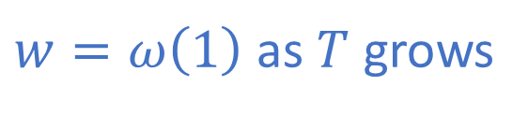
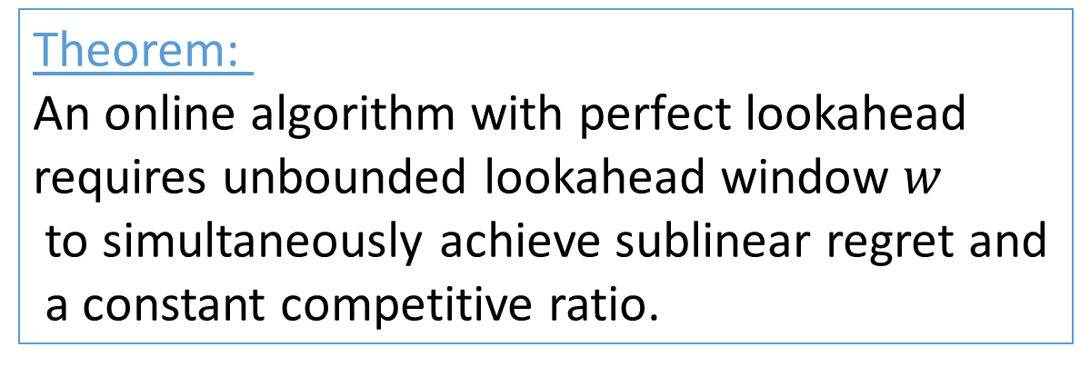
Theorem:
An online algorithm with perfect lookahead
requires unbounded lookahead window $w$
to simultaneously achieve sublinear regret and
a constant competitive ratio.
$w=ω\left(1\right)$ as $T$ grows
We may be using the wrong prediction model

Slide 19
Outline
Background : regret and competitive ratio
OCO without prediction
OCO with worst case prediction
Our prediction noise model
Algorithm design
OCO with stochastic prediction noise

Slide 20
What do we want in a prediction noise model?
Predictions are “refined” as time goes forward
Predictions are more noisy as you look
further ahead
Prediction errors can be correlated
Should be general enough to incorporate
detailed models

Slide 21
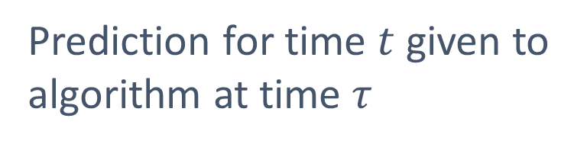
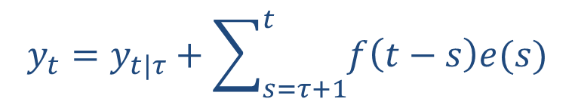
A more realistic prediction noise model
$$y_{t}=y_{t|τ}+\sum_{s=τ+1}^{t}{f\left(t−s\right)e(s)}$$
Realization that algorithm is trying to track
prediction error
Prediction for time $t$ given to
algorithm at time $τ$

Slide 22

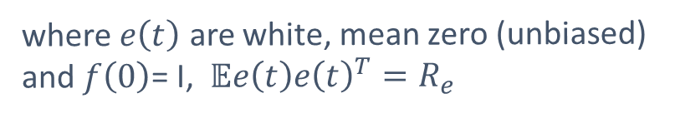
A more realistic prediction noise model
Per-step noise
$$y_{t}=y_{t|τ}+\sum_{s=τ+1}^{t}{f\left(t−s\right)e(s)}$$
How much uncertainty is there one step ahead?
$$y_{t}−y_{t|t−1}=f(0)e\left(t\right)$$
where $e\left(t\right)$ are white, mean zero (unbiased)
and $f\left(0\right)$= I, $𝔼e\left(t\right)e{\left(t\right)}^{T}=R_{e}$

Slide 23
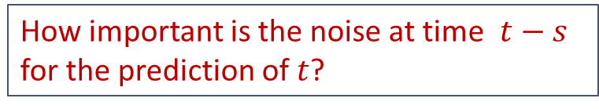
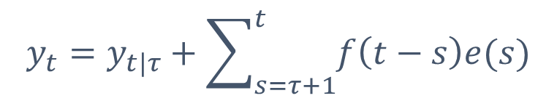
A more realistic prediction noise model
Weighting factor
$$y_{t}=y_{t|τ}+\sum_{s=τ+1}^{t}{f\left(t−s\right)e(s)}$$
How important is the noise at time $t−s$ for the prediction of $t$?

Slide 24
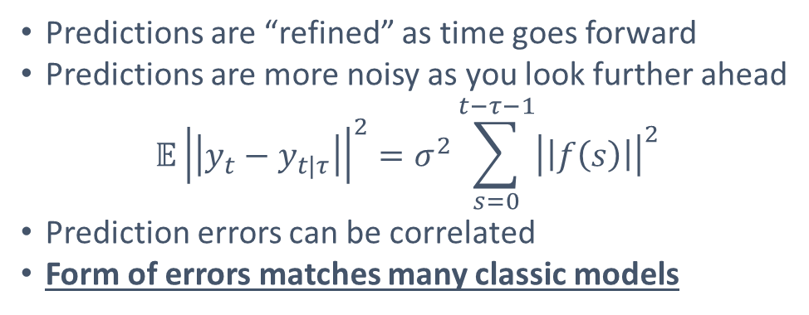
A more realistic prediction noise model
$$y_{t}=y_{t|τ}+\sum_{s=τ+1}^{t}{f\left(t−s\right)e(s)}$$
prediction error
Predictions are “refined” as time goes forward
Predictions are more noisy as you look further ahead
$$𝔼{\left|\left|y_{t}−y_{t|τ}\right|\right|}^{2}=σ^{2}\sum_{s=0}^{t−τ−1}{{\left|\left|f\left(s\right)\right|\right|}^{2}}$$
Prediction errors can be correlated
Form of errors matches many classic models

Slide 25
A more realistic prediction noise model
$$y_{t}=y_{t|τ}+\sum_{s=τ+1}^{t}{f\left(t−s\right)e(s)}$$
prediction error
This form of prediction error matches what occurs in
Prediction of a wide-sense stationary process using a Weiner filter
Prediction of a linear dynamical system using a Kalman filter

Slide 26
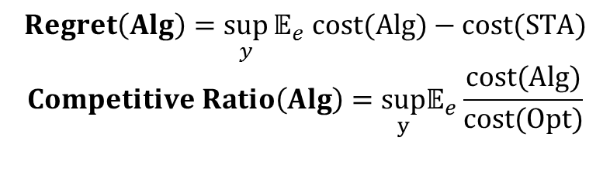
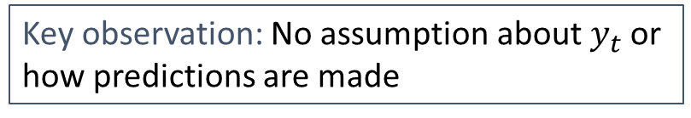
A more realistic prediction noise model
$$y_{t}=y_{t|τ}+\sum_{s=τ+1}^{t}{f\left(t−s\right)e(s)}$$
Key observation: No assumption about $y_{t}$or
how predictions are made
Allows adversarial analysis using stochastic prediction noise
$$Regret\left(Alg\right)=\sup_{y}{𝔼_{e} cost(Alg)−cost(STA)}$$
$$Competitive Ratio\left(Alg\right)=\sup_{y}𝔼_{e}\frac{cost(Alg)}{cost(Opt)}$$
Notes:
Remove bottom eqn

Slide 27
Outline
Background : regret and competitive ratio
OCO without prediction
OCO with worst case prediction
Our prediction noise model
Algorithm design
OCO with stochastic prediction noise

Slide 28
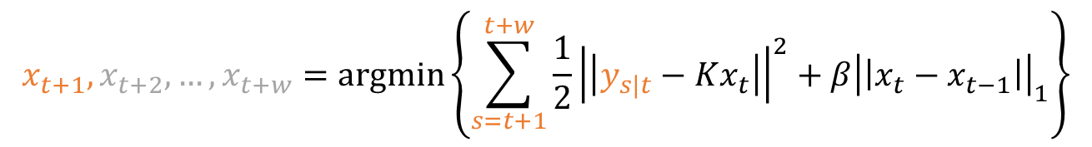
A natural suggestion: Model Predictive Control (MPC)
$$y_{t+1|t},y_{t+2|t},…,y_{t+w|t},y_{t+w+1|t},y_{t+w+2|t},…$$
$$x_{t+1},x_{t+2},…,x_{t+w}=argmin\left\{\sum_{s=t+1}^{t+w}{\frac{1}{2}{\left|\left|y_{s|t}−Kx_{t}\right|\right|}^{2}+β{\left|\left|x_{t}−x_{t−1}\right|\right|}_{1}}\right\}$$

Slide 29

A natural suggestion: Model Predictive Control (MPC)
$$y_{t+1|t},y_{t+2|t},…,y_{t+w|t},y_{t+w+1|t},y_{t+w+2|t},…$$
$$y_{t+2|t+1},y_{t+3|t+1},…,y_{t+w+1|t+1},y_{t+w+2|t+1},y_{t+w+3|t+1},…$$
$$x_{t+2}, x_{t+3}, …x_{t+w+1}$$

Slide 30

A natural suggestion: Model Predictive Control (MPC)
$$y_{t+1|t},y_{t+2|t},…,y_{t+w|t},y_{t+w+1|t},y_{t+w+2|t},…$$
$$y_{t+2|t+1},y_{t+3|t+1},…,y_{t+w+1|t+1},y_{t+w+2|t+1},y_{t+w+3|t+1},…$$
$$y_{t+3|t+2},y_{t+4|t+2},…,y_{t+w+2|t+2},y_{t+w+3|t+2},y_{t+w+4|t+2},…$$
$$x_{t+3}, x_{t+4}, …x_{t+w+2}$$
But MPC doesn’t work well in this setting …

Slide 31

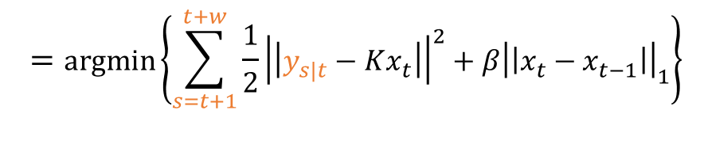
A more stable alternative: Averaging Fixed Horizon Control (AFHC)
Fixed Horizon Control (FHC)
$$y_{t+1|t},y_{t+2|t},…,y_{t+w|t},y_{t+w+1|t+w},y_{t+w+2|t+w},…$$
$$=argmin\left\{\sum_{s=t+1}^{t+w}{\frac{1}{2}{\left|\left|y_{s|t}−Kx_{t}\right|\right|}^{2}+β{\left|\left|x_{t}−x_{t−1}\right|\right|}_{1}}\right\}$$
$$x_{t+1},x_{t+2},…,x_{t+w}$$

Slide 32


A more stable alternative: Averaging Fixed Horizon Control (AFHC)
Fixed Horizon Control (FHC)
$$y_{t+1|t},y_{t+2|t},…,y_{t+w|t},y_{t+w+1|t+w},y_{t+w+2|t+w},…$$
$$x_{t+1},x_{t+2},…,x_{t+w}$$
$$x_{t+w+1},x_{t+w+2},…,x_{t+2w}$$

Slide 33

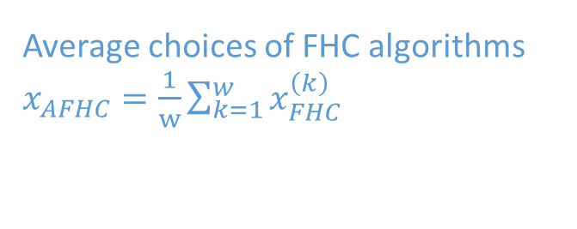
A more stable alternative: Averaging Fixed Horizon Control (AFHC)
Average choices of FHC algorithms $x_{AFHC}=\frac{1}{w}\sum_{k=1}^{w}{x_{FHC}^{\left(k\right)}}$
$$y_{t+1|t},y_{t+2|t},…,y_{t+w|t},y_{t+w+1|t+w},y_{t+w+2|t+w},…$$
$$y_{t+2|t+1},y_{t+3|t+1},…,y_{t+w+1|t+1},y_{t+w+2|t+w+1},y_{t+w+3|t+w+1},…$$
$w$ FHC algorithms
$$y_{t+3|t+2},y_{t+4|t+2},…,y_{t+w+2|t+2},y_{t+w+3|t+w+2},y_{t+w+4|t+w+2},…$$
$$y_{t+4|t+3},y_{t+5|t+3},…,y_{t+w+3|t+3},y_{t+w+4|t+w+3},y_{t+w+5|t+w+3},…$$
…

Slide 34
Outline
Background : regret and competitive ratio
OCO without prediction
OCO with worst case prediction
Our prediction noise model
Algorithm design
OCO with stochastic prediction noise

Slide 35
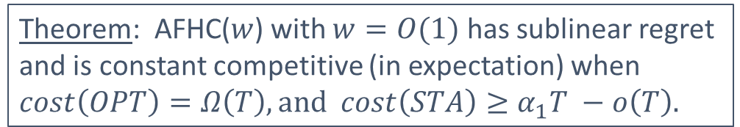
Theorem: AFHC($w$) with $w=O(1)$ has sublinear regret and is constant competitive (in expectation) when $cost\left(OPT\right)=Ω\left(T\right), and cost\left(STA\right)≥α_{1}T −o\left(T\right).$

Slide 36
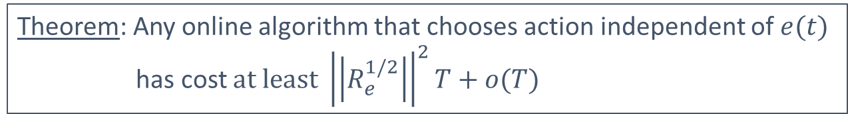
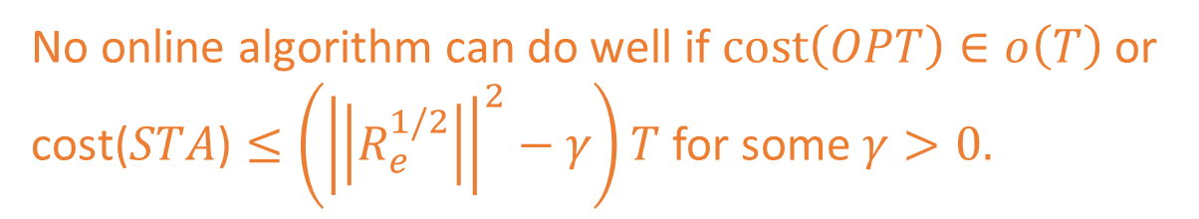
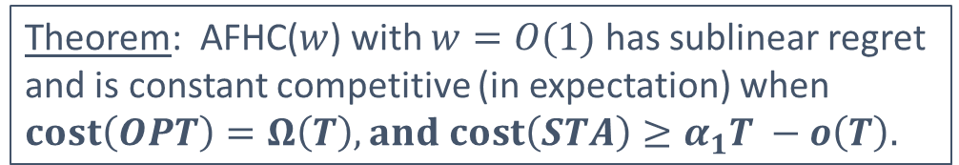
Theorem: AFHC($w$) with $w=O(1)$ has sublinear regret and is constant competitive (in expectation) when $cost\left(OPT\right)=Ω\left(T\right), and cost\left(STA\right)≥α_{1}T −o\left(T\right).$
How tight is this condition?
Theorem: Any online algorithm that chooses action independent of $e(t)$
has cost $at least {\left|\left|R_{e}^{1/2}\right|\right|}^{2}T+o(T)$
No online algorithm can do well if $cost\left(OPT\right)∈o\left(T\right)$ or
$\text{cost}\text{(}STA\text{)}≤\left({\left|\left|R_{e}^{1/2}\right|\right|}^{2}−γ\right)T$ for some $γ>0.$

Slide 37
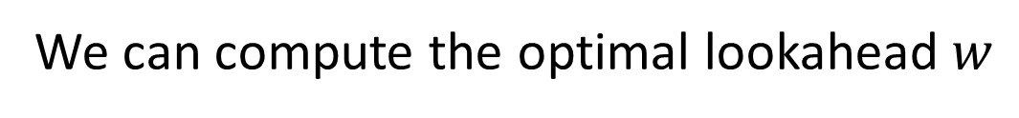
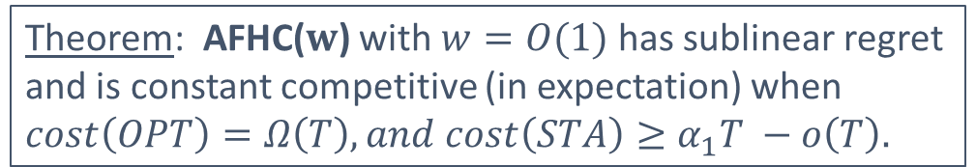
Theorem: AFHC($w$) with $w=O(1)$ has sublinear regret and is constant competitive (in expectation) when $cost\left(OPT\right)=Ω\left(T\right), and cost\left(STA\right)≥α_{1}T −o\left(T\right).$
How to choose w?
Lemma:$\sup_{y}{𝔼\left[cost\left(AFHC\right)−cost(OPT)\right]≤\frac{T}{w}\left[F\left(w\right)+g(β,K, w)\right]}$
Loss due to switching
Cumulative prediction error
over w timesteps
We can compute the optimal lookahead $w$

Slide 38
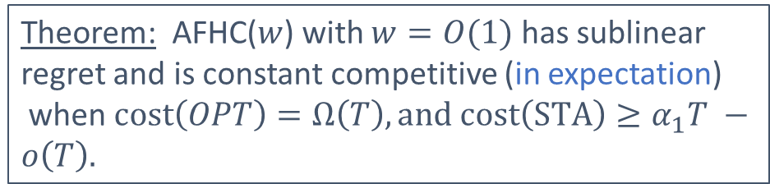
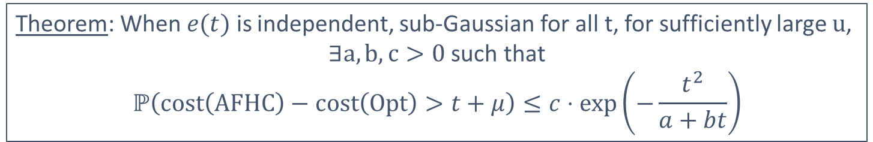
Theorem: AFHC($w$) with $w=O(1)$ has sublinear regret and is constant competitive (in expectation)
when $cost\left(OPT\right)=Ω\left(T\right),and cost\left(STA\right)≥α_{1}T −o\left(T\right).$
How likely is large deviation from expected performance for AFHC?
Theorem: When $e(t)$ is independent, sub-Gaussian for all t, for sufficiently large $u$,
$∃a,b,c>0$ such that
$$ℙ\left(cost\left(AFHC\right)−cost\left(Opt\right)>t+μ\right)≤c⋅exp\left(−\frac{t^{2}}{a+bt}\right)$$
Intuition: the competitive difference of AFHC is a “smooth” function of $e(t)$
Notes:
Change position of first thm

Slide 39
Our contribution: a general and tractable model for prediction
Key message: prediction allows
Overcoming “impossibility” results for OCO with minimal structural assumption
AFHC can achieve sublinear regret and constant CR
Balance between average case and worst case analysis
Concentration of AFHC around its mean performance

Slide 40
Online Convex Optimization Using Predictions
Niangjun Chen
Joint work with Anish Agarwal, Lachlan Andrew, Sid Barman, and Adam Wierman

Slide 41
Backup Slides

Slide 42

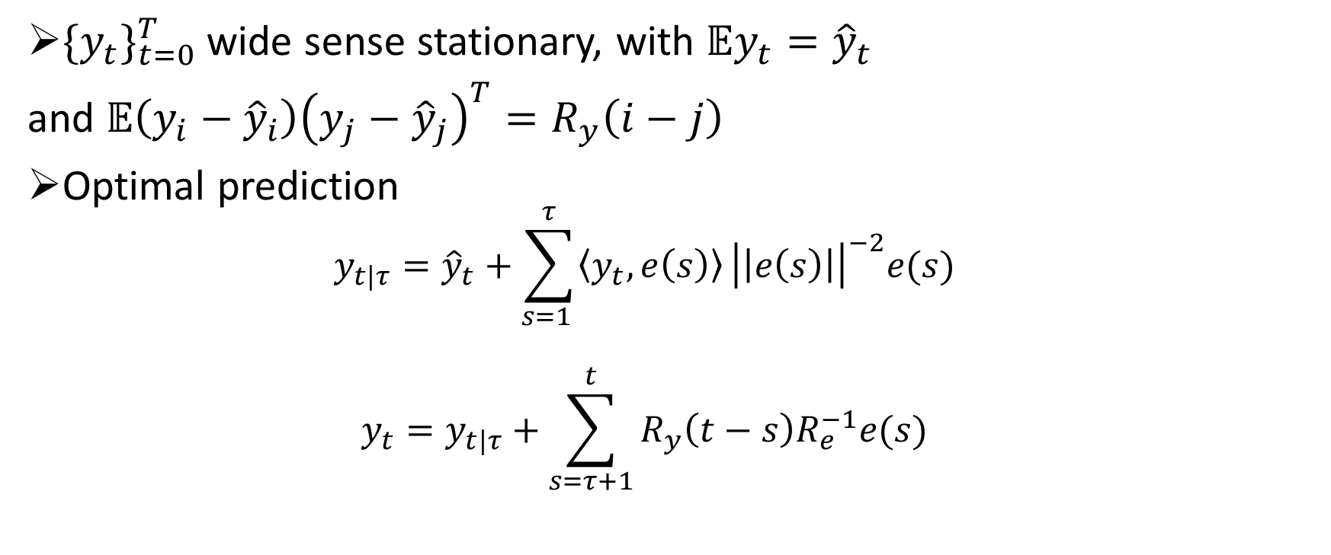
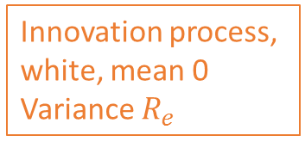
Predicting stationary process with Wiener Filter
$\{{y_{t}\}}_{t=0}^{T}$wide sense stationary, with $𝔼y_{t}={\hat{y}}_{t}$
and $𝔼\left(y_{i}−{\hat{y}}_{i}\right){\left(y_{j}−{\hat{y}}_{j}\right)}^{T}=R_{y}\left(i−j\right)$
Optimal prediction
$$y_{t|τ}={\hat{y}}_{t}+\sum_{s=1 }^{τ}{\left\langle y_{t}, e\left(s\right)\right\rangle }{\left|\left|e\left(s\right)\right|\right|}^{−2}e(s)$$
$$y_{t}=y_{t|τ}+\sum_{s=τ+1}^{t}{R_{y}\left(t−s\right)R_{e}^{−1}e(s)}$$
Innovation process,
white, mean 0
Variance $R_{e}$
$$f(t−s)$$

Slide 43

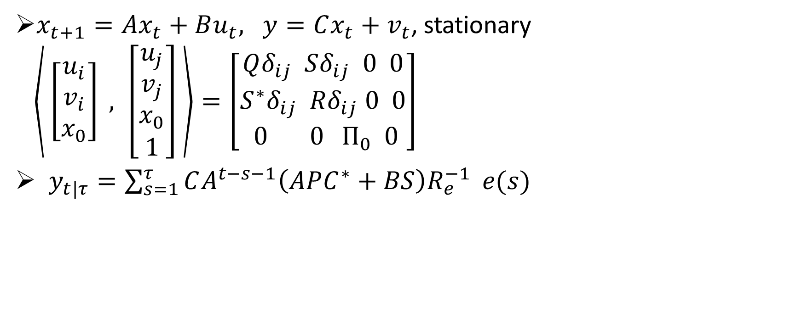
Predicting Linear Dynamical System Using Kalman Filter
$x_{t+1}=Ax_{t}+Bu_{t},$ $y=Cx_{t}+v_{t}$, stationary
$\left\langle \left[\begin{aligned}u_{i} \\ v_{i} \\ x_{0}\end{aligned}\right] , \left[\begin{aligned}u_{j} \\ v_{j} \\ x_{0} \\ 1\end{aligned}\right] \right\rangle =\left[\begin{aligned}Qδ_{ij} Sδ_{ij} 0 0 \\ S^{∗}δ_{ij} Rδ_{ij} 0 0 \\ 0 0 { Π}_{0} 0 \end{aligned}\right]$
$y_{t|τ}=\sum_{s=1}^{τ}{CA^{t−s−1}\left(APC^{∗}+BS\right)R_{e}^{−1}} e(s)$
Innovation process,
white, mean 0
Variance $R_{e}$
$$f(t−s)$$

Slide 44




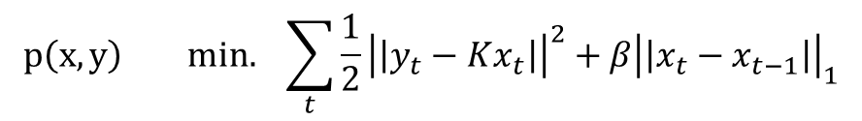
Proof Sketch
1. Within a lookahead window
$$y_{t+1|t},y_{t+2|t},…,y_{t+w|t}…$$
$$y_{t+1},y_{t+2},…,y_{t+w}$$
$$x_{t+1},x_{t+2},…,x_{t+w}$$
$$x_{t+1}^{∗},x_{t+2}^{∗},…,x_{t+w}^{∗}$$
$$p\left(x, y\right) min. \sum_{t}{\frac{1}{2}{\left|\left|y_{t}−Kx_{t}\right|\right|}^{2}+β{\left|\left|x_{t}−x_{t−1}\right|\right|}_{1}}$$
$$x=argmin_{x} p\left(x, y_{•|t}\right) x^{∗}=argmin_{x}p(x, y)$$
By perturbation analysis using Fenchel-Rockafellar duality
$p\left(x,y \right)− p\left(x^{∗} ,y\right)≤ \sum_{t}{\frac{1}{2}{\left|\left|KK^{†}\left(y_{•|t} −y_{t}\right)\right|\right|}^{2}}$
Prediction error

Slide 45

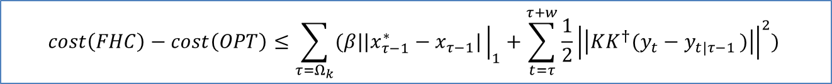

Proof Sketch
2. Between lookahead windows
$$y_{t+1|t},y_{t+2|t},…,y_{t+w|t},y_{t+w+1|t+w},y_{t+w+2|t+w},…$$
$$x_{t+1},x_{t+2},…,x_{t+w}$$
$$x_{t+w+1},x_{t+w+2},…,x_{t+2w}$$
cost between lookahead window
$$cost\left(FHC\right)−cost\left(OPT\right)≤\sum_{τ=Ω_{k}}{(β||x_{τ−1}^{∗}}−x_{τ−1}|{\left.​\right|}_{1}+\sum_{t=τ}^{τ+w}{\frac{1}{2}{\left|\left|{KK^{†}(y}_{t}−y_{t|τ−1 })\right|\right|}^{2}) }$$

Slide 46

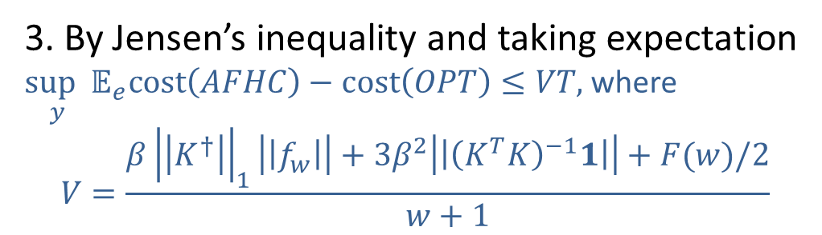

Proof Sketch
$w$ FHC algorithms
…
Average choices of FHC algorithms
3. By Jensen’s inequality and taking expectation
$\sup_{y}𝔼_{e}cost\left(AFHC\right)−cost\left(OPT\right)≤VT,$ where
$$V=\frac{β{\left|\left|K^{†}\right|\right|}_{1}\left|\left|f_{w}\right|\right|+3β^{2}\left|\left|{\left(K^{T}K\right)}^{−1}1\right|\right|+F(w)/2}{w+1}$$
Switching cost
Prediction error
Lookahead window $w$

Slide 47
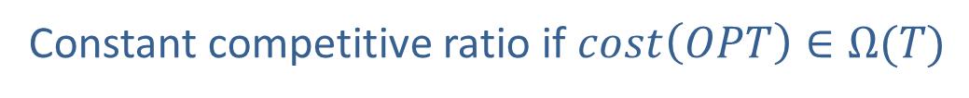

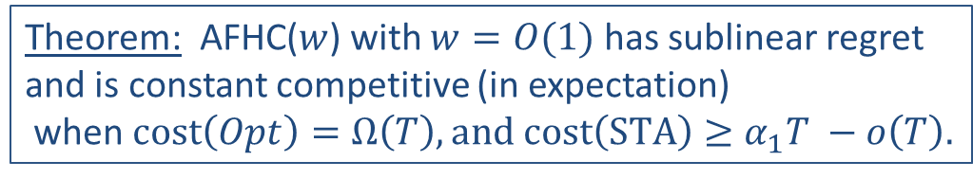
Proof Sketch
$𝔼cost\left(AFHC\right)−cost\left(OPT\right)≤VT$ implies
Constant competitive ratio if $cost\left(OPT\right)∈Ω(T)$
4. Similarly for regret
Theorem: AFHC($w$) with $w=O(1)$ has sublinear regret and is constant competitive (in expectation)
when $cost\left(Opt\right)=Ω\left(T\right), and cost\left(STA\right)≥α_{1}T −o\left(T\right).$

Slide 48
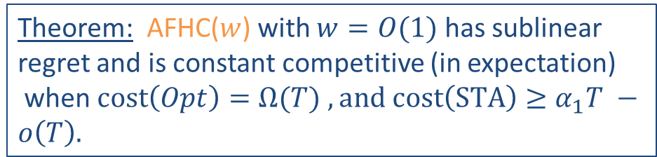
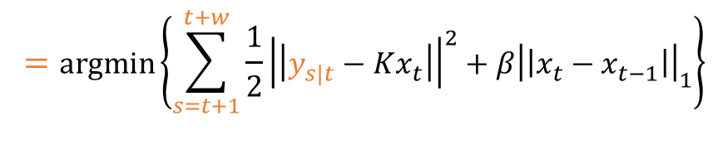
Theorem: AFHC($w$) with $w=O(1)$ has sublinear regret and is constant competitive (in expectation)
when $cost\left(Opt\right)=Ω(T)$ $, and cost\left(STA\right)≥α_{1}T −o\left(T\right).$
Averaging Fixed Horizon Control
Fixed Horizon Control
$$y_{t+1|t},y_{t+2|t},…,y_{t+w|t},y_{t+w+1|t+w},y_{t+w+2|t+w},…$$
$$=argmin\left\{\sum_{s=t+1}^{t+w}{\frac{1}{2}{\left|\left|y_{s|t}−Kx_{t}\right|\right|}^{2}+β{\left|\left|x_{t}−x_{t−1}\right|\right|}_{1}}\right\}$$
$$x_{t+1},x_{t+2},…,x_{t+w}$$

Slide 49
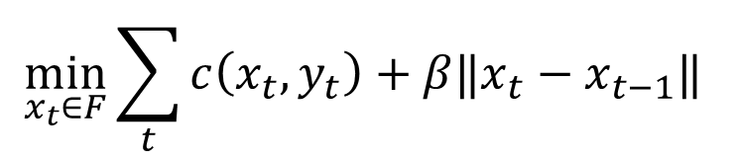

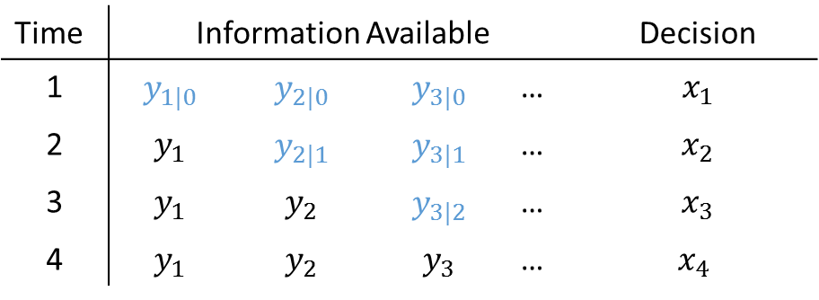

Online Convex Optimization
Using Predictions
$$x_{1},y_{1},x_{2},y_{2},x_{3},y_{3},…$$
online
$$\min_{x_{t}∈F}{\sum_{t}{c\left(x_{t}, y_{t}\right)}+β‖x_{t}−x_{t−1}‖ }$$
switching cost
convex
e.g. $c(x_{t},y_{t})=\frac{1}{2}{\left|\left|y_{t}−Kx_{t}\right|\right|}^{2}$
Goal: Algorithms to minimize cost
Time | Information Available |  |  |  | Decision
1 | $$y_{1|0}$$ | $$y_{2|0}$$ | $$y_{3|0}$$ | … | $$x_{1}$$
2 | $$y_{1}$$ | $$y_{2|1}$$ | $$y_{3|1}$$ | … | $$x_{2}$$
3 | $$y_{1}$$ | $$y_{2}$$ | $$y_{3|2}$$ | … | $$x_{3}$$
4 | $$y_{1}$$ | $$y_{2}$$ | $$y_{3}$$ | … | $x_{4}$
Notes:
Parameterized family , available information at time t

Slide 50
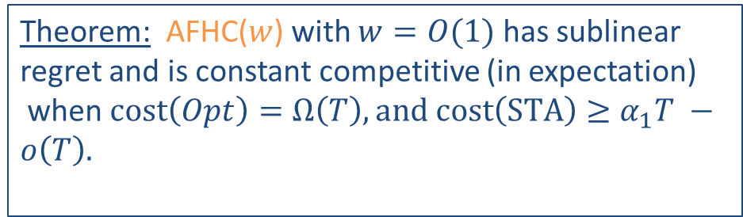


Theorem: AFHC($w$) with $w=O(1)$ has sublinear regret and is constant competitive (in expectation)
when $cost\left(Opt\right)=Ω\left(T\right), and cost\left(STA\right)≥α_{1}T −o\left(T\right).$
Averaging Fixed Horizon Control
Fixed Horizon Control
$$y_{t+1|t},y_{t+2|t},…,y_{t+w|t},y_{t+w+1|t+w},y_{t+w+2|t+w},…$$
$$x_{t+1},x_{t+2},…,x_{t+w}$$
$$x_{t+w+1},x_{t+w+2},…,x_{t+2w}$$

Slide 51
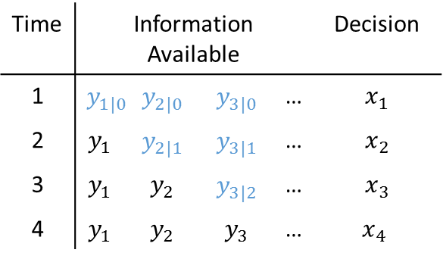

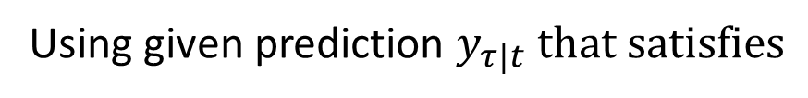
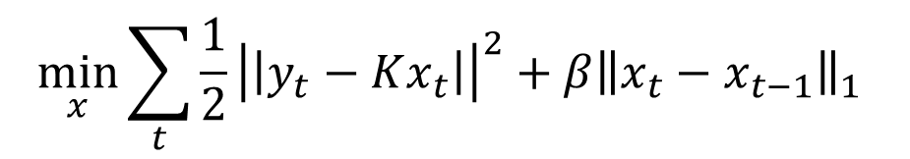
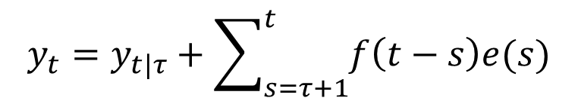
Online Convex Optimization
Using Predictions
$$x_{1},y_{1},x_{2},y_{2},x_{3},y_{3},…$$
online
Time | Information Available |  |  |  | Decision
1 | $$y_{1|0}$$ | $$y_{2|0}$$ | $$y_{3|0}$$ | … | $$x_{1}$$
2 | $$y_{1}$$ | $$y_{2|1}$$ | $$y_{3|1}$$ | … | $$x_{2}$$
3 | $$y_{1}$$ | $$y_{2}$$ | $$y_{3|2}$$ | … | $$x_{3}$$
4 | $$y_{1}$$ | $$y_{2}$$ | $$y_{3}$$ | … | $x_{4}$
$$\min_{x}{\sum_{t}{\frac{1}{2}{\left|\left|y_{t}−Kx_{t}\right|\right|}^{2}}+β{\left\|x_{t}−x_{t−1}\right\|}_{1} }$$
Using given prediction $y_{τ|t} that satisfies$
$$y_{t}=y_{t|τ}+\sum_{s=τ+1}^{t}{f\left(t−s\right)e(s)}$$
Is there online algorithm that achieve sublinear regret and constant CR?
Yes!

Slide 52
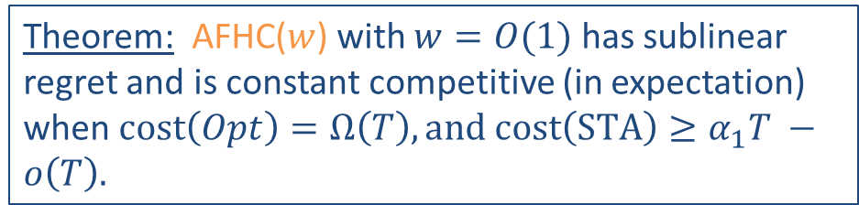
Theorem: AFHC($w$) with $w=O(1)$ has sublinear regret and is constant competitive (in expectation)
when $cost\left(Opt\right)=Ω\left(T\right), and cost\left(STA\right)≥α_{1}T −o\left(T\right).$
Averaging Fixed Horizon Control
$$y_{t+1|t},y_{t+2|t},…,y_{t+w|t},y_{t+w+1|t+w},y_{t+w+2|t+w},…$$
$$y_{t+2|t+1},y_{t+3|t+1},…,y_{t+w+1|t+1},y_{t+w+2|t+w+1},y_{t+w+3|t+w+1},…$$
$w$ FHC algorithms
$$y_{t+3|t+2},y_{t+4|t+2},…,y_{t+w+2|t+2},y_{t+w+3|t+w+2},y_{t+w+4|t+w+2},…$$
$$y_{t+4|t+3},y_{t+5|t+3},…,y_{t+w+3|t+3},y_{t+w+4|t+w+3},y_{t+w+5|t+w+3},…$$
…
Average choices of FHC algorithms

